Slide 1
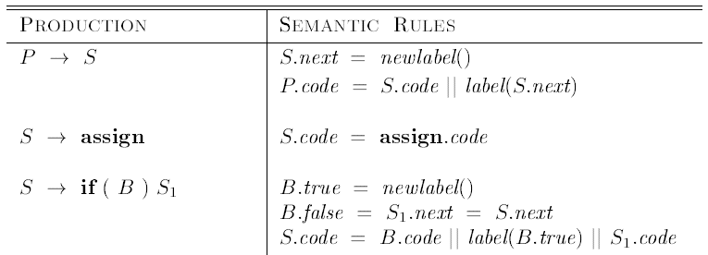
Syntax Directed Definition for flow of control statements
next, true, false-inherited attributes
code- synthesized attribute

Slide 2
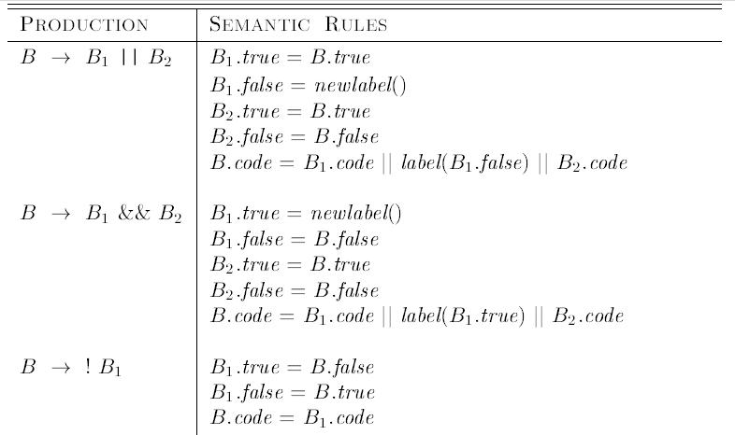

Control-Flow Translation of Boolean Expressions

Slide 3
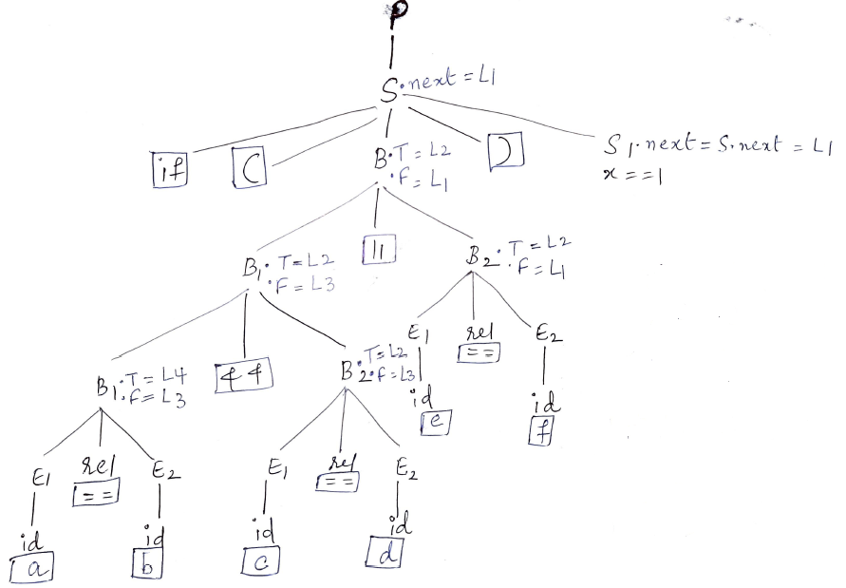
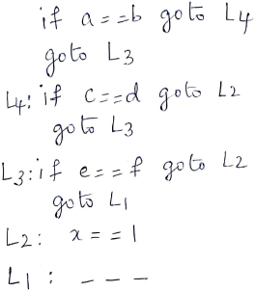


Three Address Code

Slide 4










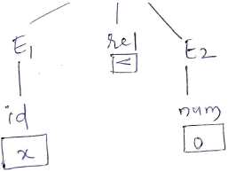




Three Address Code:

Slide 5









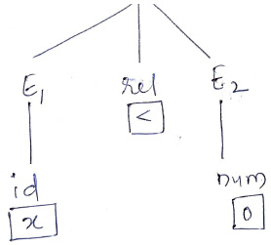







Three Address Code

Slide 6


Syntax Directed Definition for flow of control statements

Slide 7
